Slide 1
Spectrum/AIM Overview
2019 HIV Estimates Workshop

Slide 2
Outline
Overview of Spectrum / EPP
Changes to Spectrum from 2016 -> 2018
County estimation
Practice session
Discussion

Slide 3
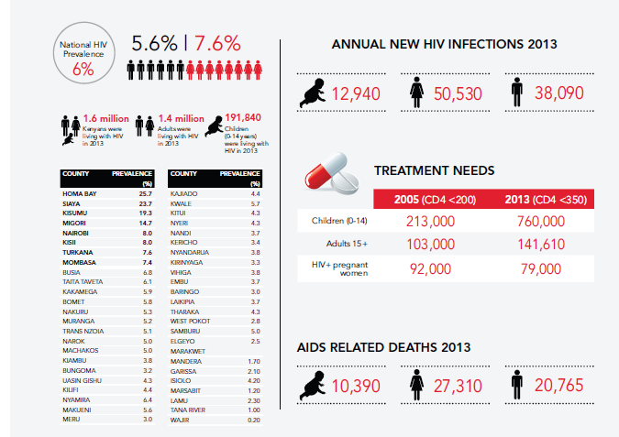
Why we use HIV estimates

Slide 4
How Kenya’s Estimate are aggregated / disaggregated
National Estimate
Nairobi
Nairobi
Coast
Mombasa
[…]
Central
Nyeri
[…]
[…]
Aggregation
disaggregation

Slide 5
Why we use Spectrum / EPP
For HIV epidemiology, provides tools to answer questions that are hard to measure directly in many settings, for example:
Programmatic Questions:
How many people are living with HIV in 2018 in Kenya?
How many PLHIV are eligible for ART under current Kenya treatment guidelines?
What is the treatment coverage of the national PMTCT program?
Impact Questions:
What are recent trends in incidence of HIV infection?
How many deaths due to HIV in 2018 in Kenya?
What is the impact of scale-up of public health interventions on the epidemic?

Slide 6
The Spectrum Suite
DemProj: Demography
FamPlan: Family Planning
LiST: Lives Saved Tool (Child Survival)
AIM: AIDS Impact Model
Goals: Cost and impact of HIV Intervention
Resource Needs Module: Costs of implementing an HIV/AIDS program
RAPID: Resources for the Awareness of Population Impacts on Development

Slide 7
Structure
Demographic Data
Demographic and Epidemic Calculations
Mother-to-child transmission
Child model
Adult model
Results
Number HIV+
New Infections
AIDS deaths
Need for ART
Need for PMTCT
Program Statistics
Epidemic Patterns
Surveillance and Survey Data
Prevalence / incidence trend

Slide 8
DemProj
Demographic Projection Module

Slide 9
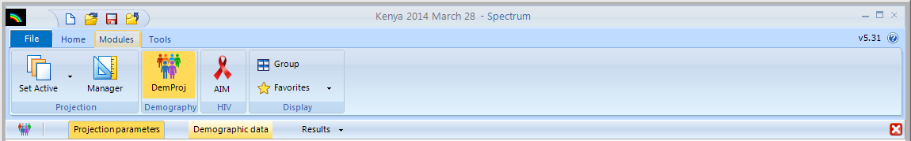
DemProj
Demproj uses the following to develop a demographic population projection:
Base-year population by 5-year age group and sex
Annual projected TFR, ASFR, life expectancy
Annual life expectancy and a life table
International migration by year

Slide 10
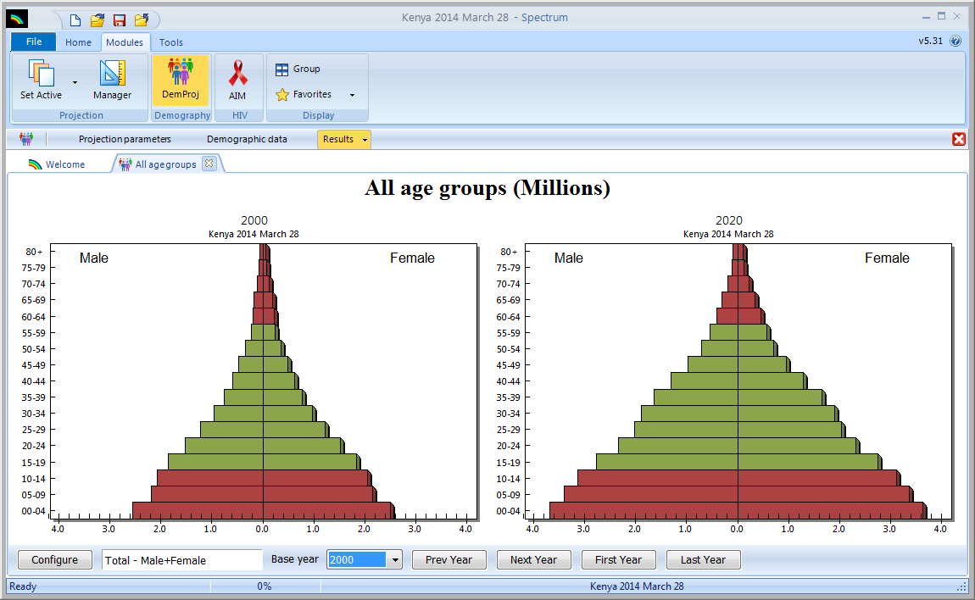
DemProj
In return, DemProj gives us an estimated population size, age/sex structure, births, deaths, for every year
NOTE: The demographic projection must be “without AIDS”

Slide 11
AIM
AIDS Indicator Module

Slide 12
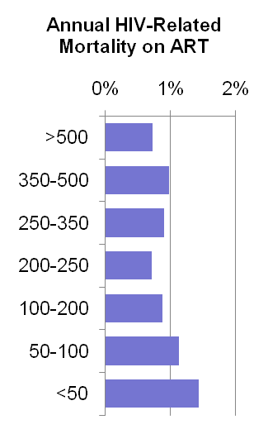
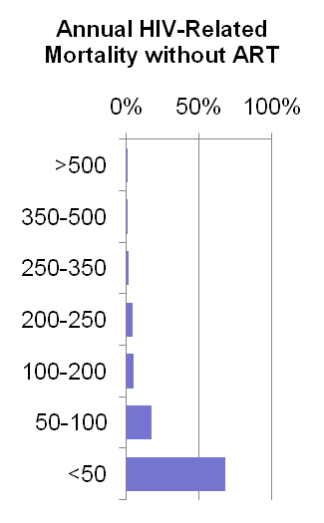
Adult CD4 Model
New Infections
>500
350-499
250-349
200-249
100-199
50-99
<50
On ART
μ
λ
c
α
>500
μ
λ
c
α
350-499
μ
λ
c
α
250-349
μ
λ
c
α
200-249
μ
λ
c
α
100-199
μ
λ
c
α
50-99
μ
λ
c
α
<50
Separate patterns for 0-6, 7-12 and 12+ months on ART
AIDS Death

Slide 13
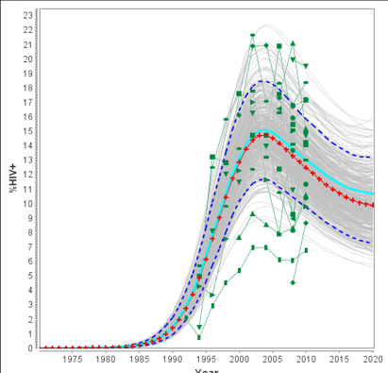
Structure of child model in Spectrum AIDS Impact Module
1 Demographic Data
Total fertility rate
Age distribution of fertility
Number of women aged 15-49 years (by five-year age group)
15 AIDS-related deaths among children
5 Number of births to HIV+ women
6 Number of women receiving ARV prophylaxis or treatment by regimen
14 Survival among children receiving ART
2 Surveillance and survey
Data
7 Number of children born HIV+
12 Disease progression among children not receiving ART
13 Distribution of age of ART initiation
3 Epidemic Patterns
Female/male ratio of incidence
Age distribution of incidence
Mortality
8 Breastfeeding Patterns + incidence during BF
11 Number of children receiving ART and contrimoxazole
9 Number of new child HIV infections
4 Fertility Adjustment
Reduced fertility among HIV+ women
10 Children living with HIV
Assumptions
Country team input
Calculation
Notes:
Courtesy of UNAIDS (update to child estimates, May, 2017 presentation)

Slide 14
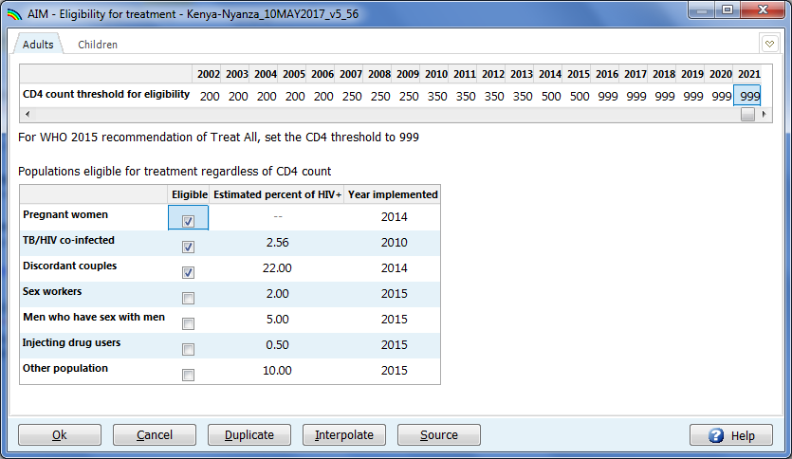
Define Eligibility Criteria for Treatment
Notes:
For Kenya, we are now in the “test and treat” era, so everyone infected with HIV is immediately eligible for treatment. Major changes in eligibility were in 2007 (transition to CD4 250), 2010 (350), 2014 (500), and 2016 (no cutoff). B+ started around 2014, as did eligibility for the infected partner in a discordant couple, whereas TB/HIV became a criteria for initiation in 2010.

Slide 15
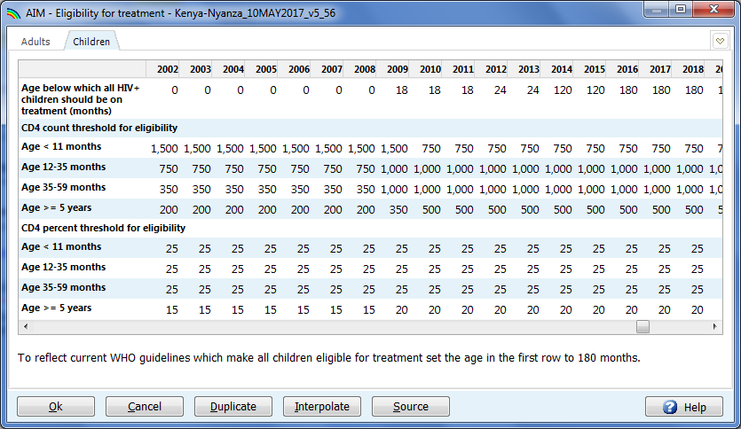
Define Eligibility Criteria for Treatment
Notes:
For children, all PLHIV became eligible in 2016.

Slide 16
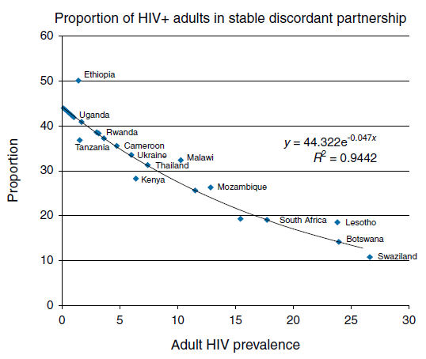
Eligibility criteria – discordant couples
Notes:
Studies using AIDS indicator and DHS surveys in many countries have found a consistent relationship between the proportion of HIV+ adults in a stable discordant relationship, and the overall adult HIV prevalence. These data are used to predict what proportion of PLHIV are in stable discordant relationships and hence eligible for ART in countries like Kenya where this was a criterion for ART initiation.
Although no longer an eligibility criteria, this was important in the past, and as the model is temporal, it is still important to Spectrum.

Slide 17
PMTCT Data Required
Perinatal Prophylaxis
Postnatal
None
Single dose Nevirapine
Dual ARVs
Option A
Option B
ART started before current pregnancy
ART started during current pregnancy >4 weeks before delivery
ART started during current pregnancy <4 weeks before delivery
Number starting postnatal prophylaxis for Option A and Option B
ART retention during pregnancy*
Monthly drop-out rates during breastfeeding for Opt A, Opt B, ART
Duration of breastfeeding (Default data from DHS)
Notes: * Updated in 2017 to assume 75% ART retention for women previously on ART, and 80%
for those initiating due to pregnancy (previous default was 100% retention).
Notes:
For Kenya, we assumed 85% retention among pregnant women, based on the 2015 cohort analysis.

Slide 18
Treatment Data Required
Adults
Children
Number or percent of eligible adults on ART by sex and year
Median CD4 count at treatment initiation
Percent lost to follow up each year
Alternatives
Number newly starting ART each year
Number or percent by CD4 count
Number of children receiving cotrimoxazole by year
Number of children on ART by year
Percent receiving early infant diagnosis (EID)
Notes: * Spectrum estimates coverage and impact of ART on transmission and survival based on currently on ART, however LTFU can influence mortality and transmission as time on ART influences both.
Notes:
* Spectrum estimates coverage and impact of ART on transmission and survival based on currently on ART, however LTFU can influence mortality and transmission as time on ART influences both.

Slide 19
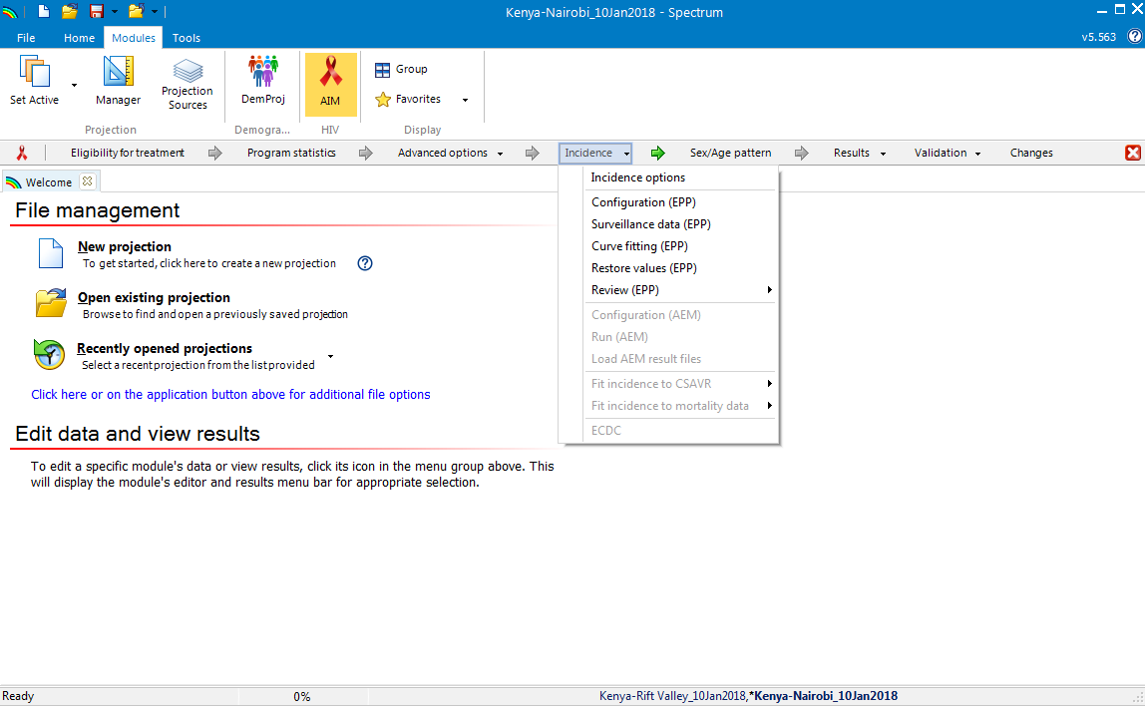
Estimate Incidence
Requires data on HIV mortality over time. Can also use data on the number of PLHIV and new cases
Notes:
It is not enough to know how many people are infected – we must also estimate how long they have been infected in order to progress them through the CD4 model and establish eligibility for treatment. Therefore, EPP is used to estimate trends in HIV incidence from available epidemiological data on HIV prevalence.
AEM = AIDS Epidemic Model, CSAVR = Case Surveillance and Vital Registration)

Slide 20
EPP Overview

Slide 21
Structure
Demographic Data
Demographic and Epidemic Calculations
Mother-to-child transmission
Child model
Adult model
Results
Number HIV+
New Infections
AIDS deaths
Need for ART
Need for PMTCT
Program Statistics
Epidemic Patterns
Surveillance and Survey Data
Prevalence / incidence trend

Slide 22
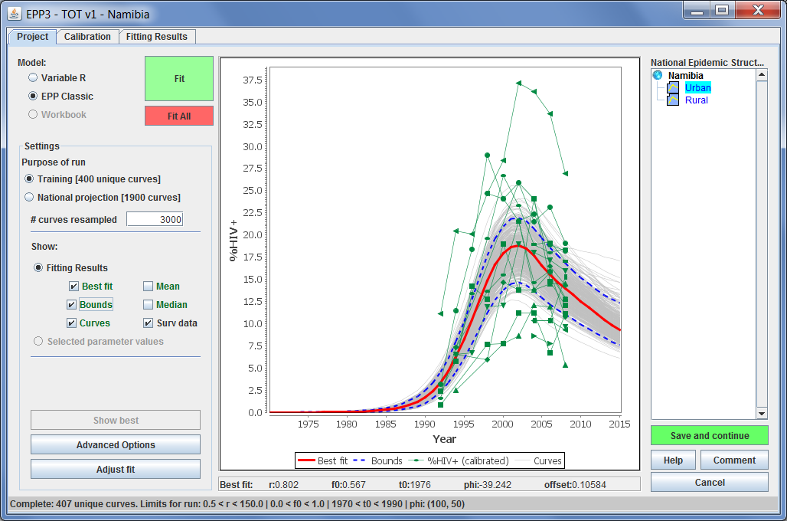
What is EPP?
Estimation and Projection Package
Uses observed prevalence trends to calculate incidence trends over time
Limited to 15-49 age group
Input: Surveillance data and data from Spectrum
Output: Incidence among population 15-49

Slide 23
Details
Model includes 15 year olds living with HIV who enter the 15-49 population (data from Spectrum previous fit)
Incidence assays can be incorporated into the fitting
Includes population-based survey estimates as well as health facility prevalence estimates (ANC data – both sentinel surveillance and routine ANC)

Slide 24
Summarized EPP fitting procedure
Generate random curves
Select curves based on goodness-of-fit
Do weighted resampling of curves, with replacement
Keep unique curves
The distribution of unique resampled curves determines median curve and 95% uncertainty bounds

Slide 25
Current EPP Model Options
EPP Classic – simple “SIR” model: simplest
R-Spline – reproductive rate r(t) changes over time - fit using regression splines: most flexible
R-Trend – similar to R-Spline but penalizes changes in r(t) over time: more efficient
R-Hybrid – precisely captures trends in recent years

Slide 26
New EPP Features
Allow the “equilibrium prior” to be relaxed
An “age/sex model” to fit age- and sex-specific prevalence from surveys directly in EPP
Fit static sex ratios and dynamic age incidence rate ratios in EPP proper (not just Spectrum)
Add an “R-logistic / random walk” model to more closely fit incidence from 2006 to end of projection

Slide 27
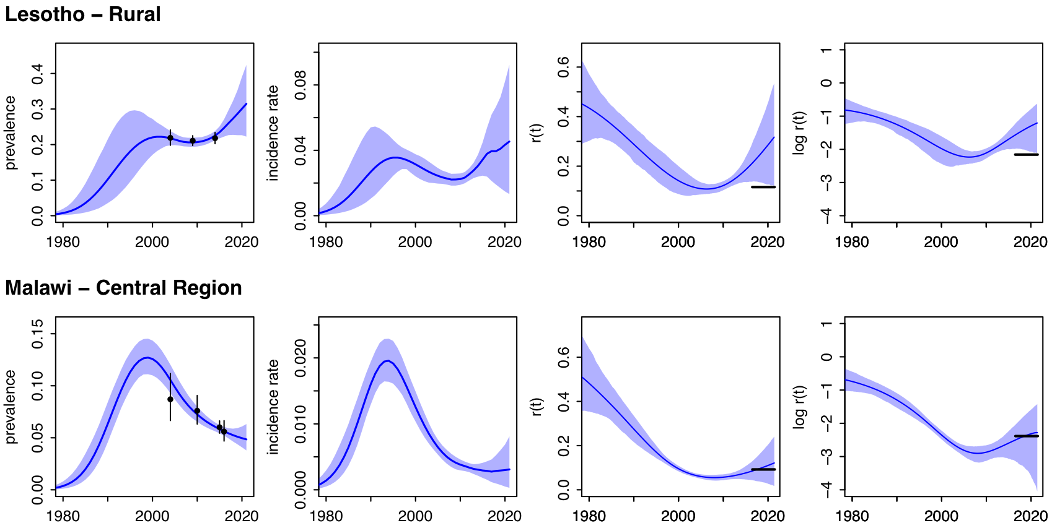
Removing the equilibrium prior
Notes:
Equilibrium prior imposes belief that r(t) will remain steady in absence of new info
But draws transmission towards arbitrary value, and also influences trend during the period in which data are available
The two new models used in Kenya do NOT rely on the equilibrium prior

Slide 28
Nyanza
Key:
Purple / dashed – Spectrum 5.63
Green – rLRW
Red – RSpline ASM
Pink squares – ANC RT Census
Gray lines – ANC SS / RT

Slide 29
Nyanza – survey age/sex prevalence fits
Key: red – “rlogistic-rw”, green – “Rspline-ASM”, black dots/bars – pop surveys

Slide 30
Nyanza – temporal prevalence trends by age/sex
Key: red – “rlogistic-rw”, green – “Rspline-ASM”, black dots/bars – pop surveys

Slide 31
Results of EPP
An incidence curve which is fed back into Spectrum to generate results for other indicators

Slide 32
Results: Key Output Indicators
Indicators
HIV+ population
New infections
HIV-related deaths
Need for ART
Need for PMTCT
Orphans
Population Groups
All ages
Adults 15-49
Adults 15+
Young people 15-24
Pregnant women
Children 0-14
Children 0-1
Children 1-4
Children <2
Regions

Slide 33
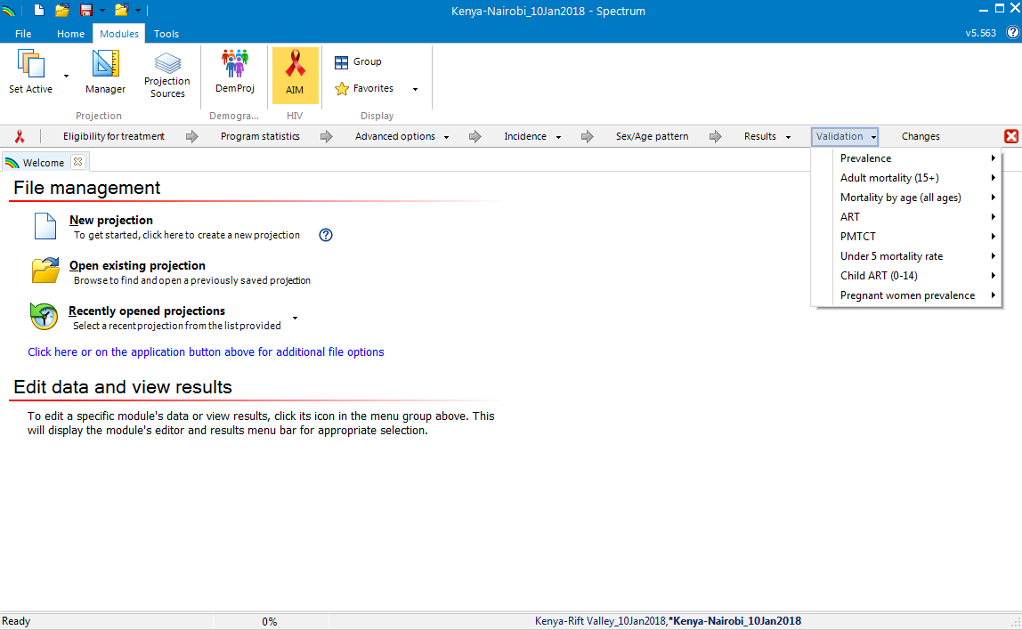
Validation

Slide 34
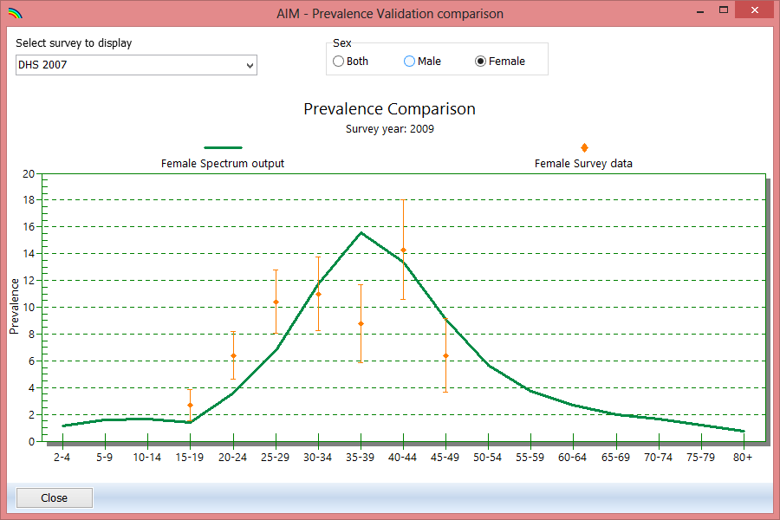
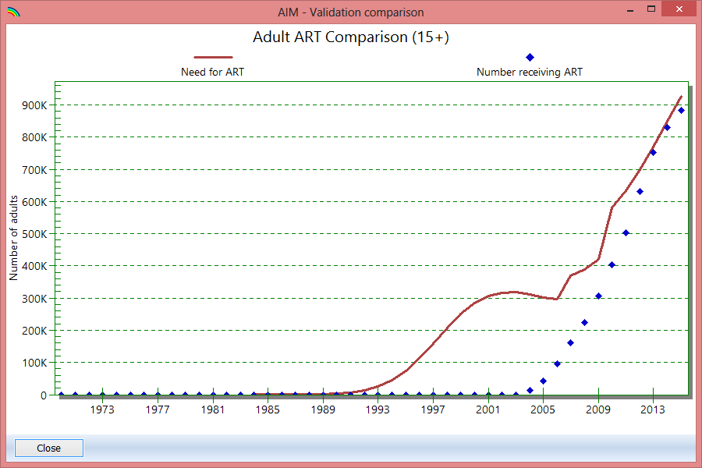
Validation
Notes:
Validations performed for 2016 Kenya estimates:
- Compared age distribution of prevalence for provinces with KAIS 2012
Checked/revised projected TFRs per province against KDHS 2014
Checked TDR ratios against KDHS 2014
Checked resulting coverage of ART and PMTCT against program data
Checked age/sex distribution against KNBS Census results for Nairobi

Slide 35
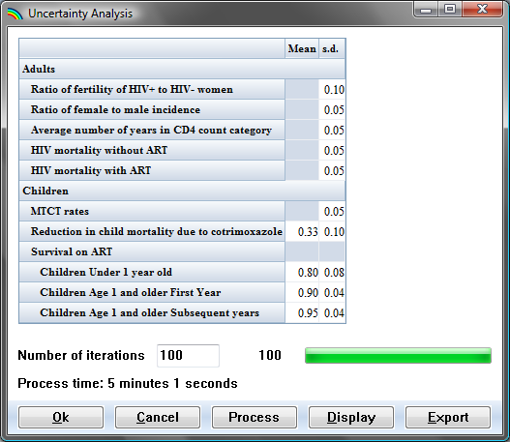
Uncertainty Analysis
Notes:
Montecarlo simulations are performed to vary key parameters in the model and develop lower and upper uncertainty bounds. Some of the key assumptions that are varied in the analysis are the ratio of male to female incidence, ratio of fertility among HIV+ and HIV- women, and HIV mortality with/without HIV

Slide 36
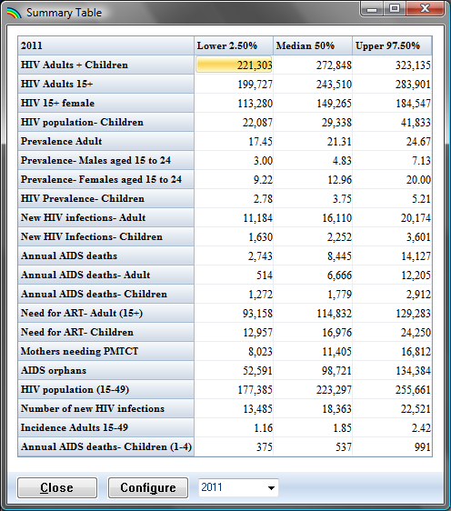
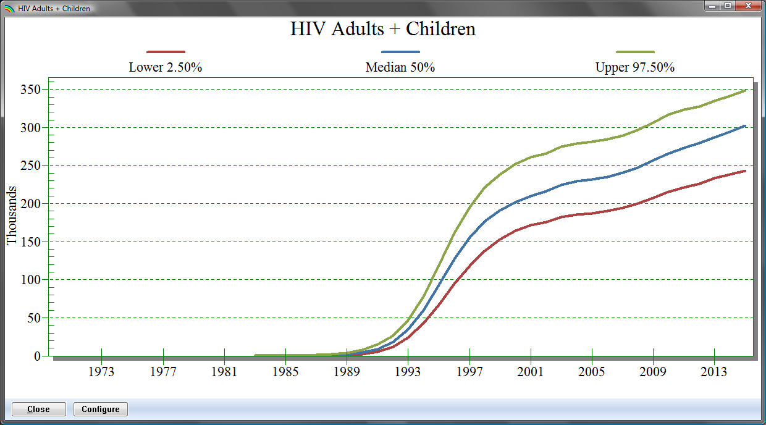
Uncertainty Analysis

Slide 37
Epidemiological underpinnings of EPP / Spectrum

Slide 38
Spectrum: A few key changes
Implementation of age/sex model in EPP (though not fully utilized yet)
Revision of default PMTCT dropout rates from 0% to 20-25%
Updates to PMTCT transmission probabilities based on latest evidence
Updates to incident infection during breastfeeding from first 12 months to cover entire period
Updated ART survival based on new data from IeDEA consortium
=> all of these changes can impact the results

Slide 39
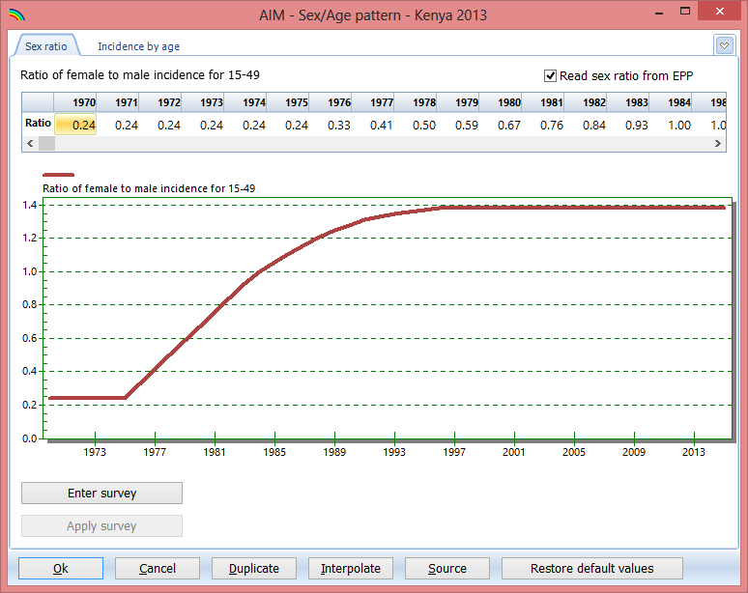
Female / Male Ratio of Incidence
Notes:
Since much epi data is not very detailed (ANC surveillance) the EPP model is fit using total population. Therefore, the resulting incidence must be allocated to women and men by applying an incidence ratio.

Slide 40
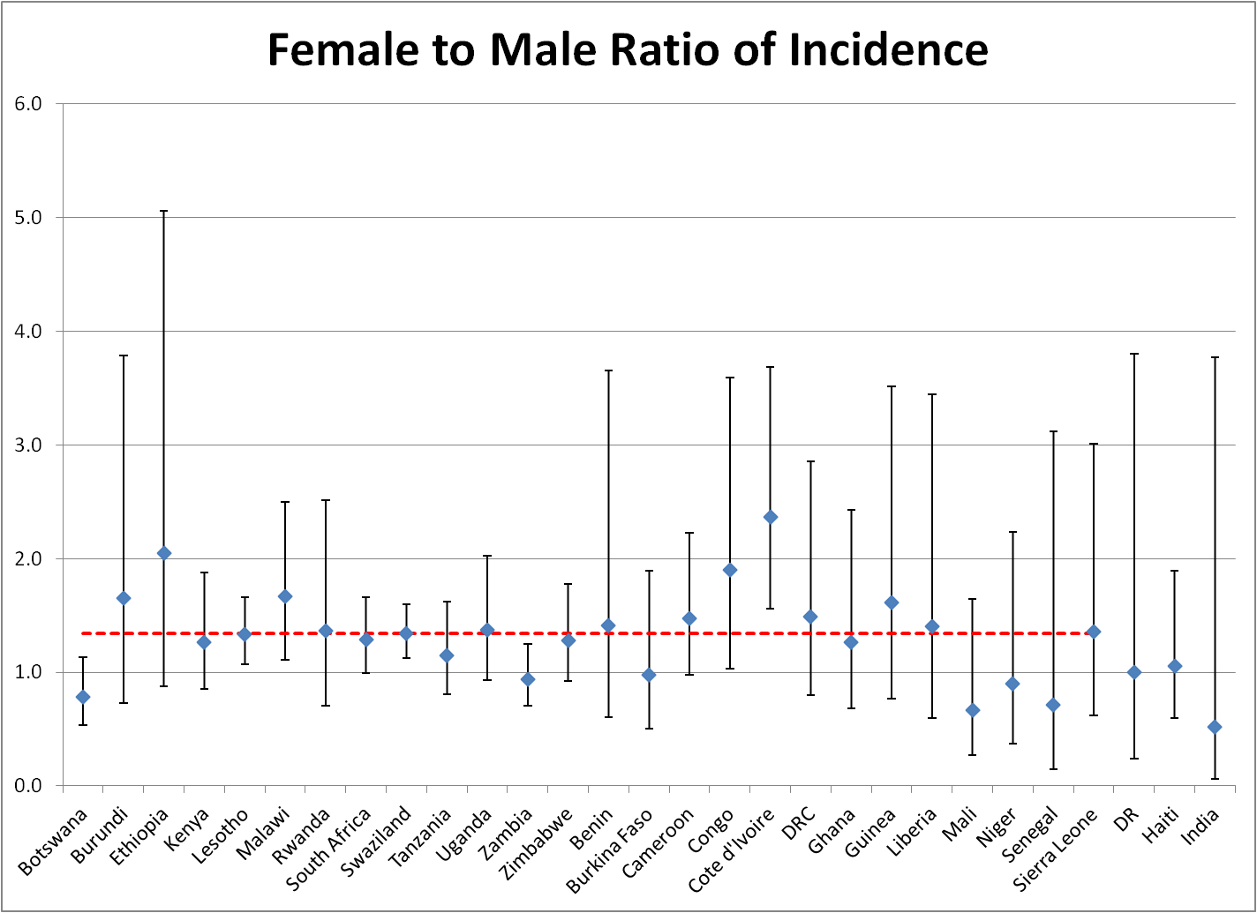
Sex Ratio of Incidence
1.38 – Generalized
0.42 - Concentrated
Notes:
Analyses of AIS and DHS data have shown that the prevalence ratio, and hence the incidence ratio between females and males tends to be >1 in generalized epidemics like in Kenya. I.e. for every new male infection, there is more than one new female infection.

Slide 41
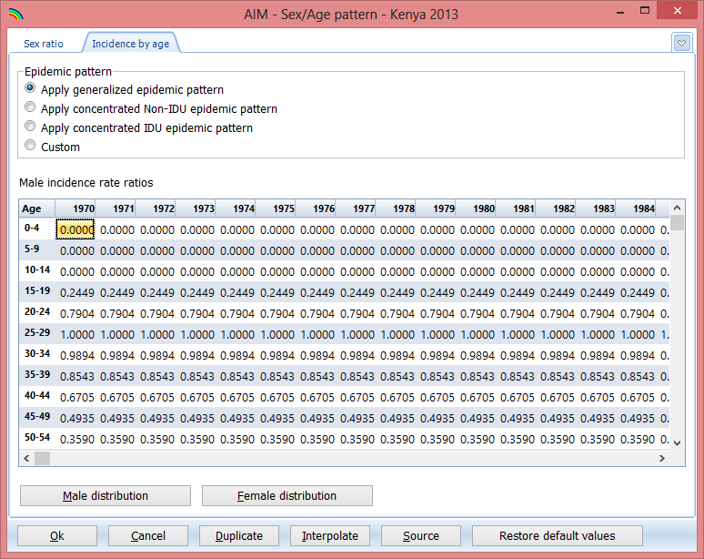
Incidence Rate Ratios by Age
Notes:
Furthermore, since EPP is fitting all adults aged 15-49 we must also distribute the resulting new infections by age. This is done by applying “incidence rate ratios” which basically say for every new infection among 25-29 year olds, how many new infections do we get among 15-19, 20-24, 30-34, etc. This is done separately for men and women.

Slide 42
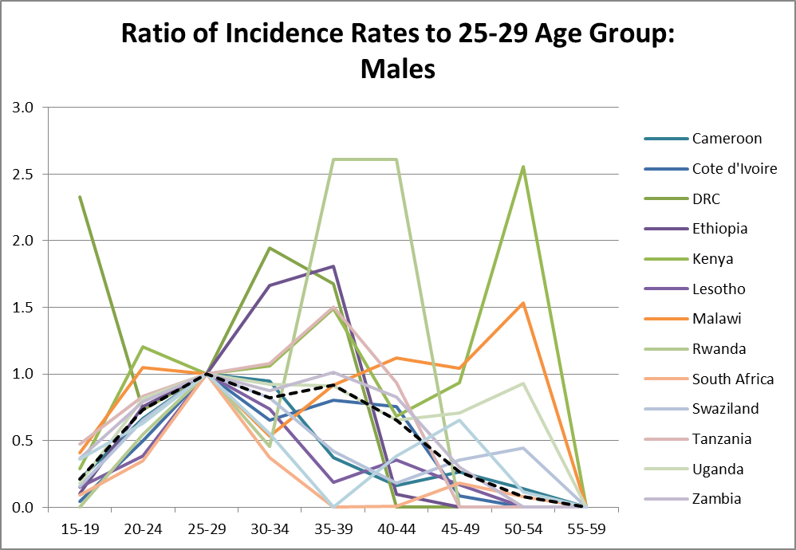
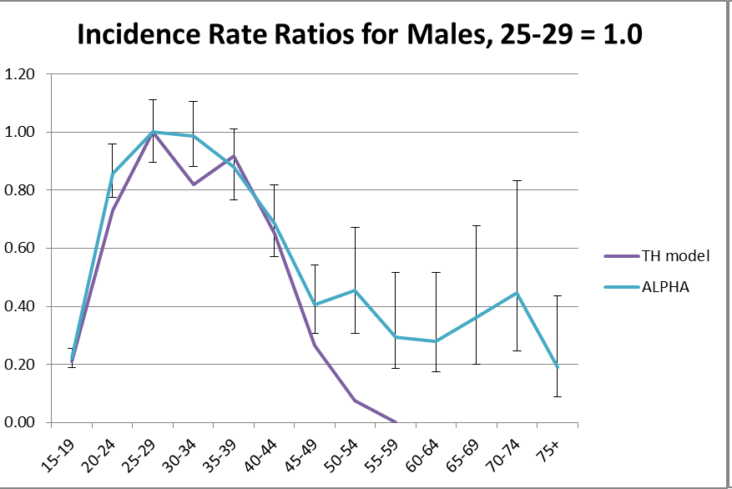
Incidence Rate Ratios
Estimate Incidence Pattern from National Prevalence Surveys
Compare to Incidence Pattern from ALPHA Network
Hallett TB, Stover J, Mishra V, Ghys PD, Gregson S, Boerma T. Estimates of HIV incidence from household-based prevalence surveys AIDS 2010; 24:147-52.
Basia Zaba, Age-Specific Patterns of Incidence: ALPHA sites, 1995-2010, presented at UNAIDS Reference Group Meeting, Dec 5, 2012, Geneva.
Notes:
The evidence for these is based on studies of AIS and DHS on the one hand (left side) and from ALPHA network on the other. Unlike the national prevalence surveys, the ALPHA network actually measure incidence in cohorts. The ALPHA network data are smoother and are what are used to set the ratios in Spectrum.

Slide 43
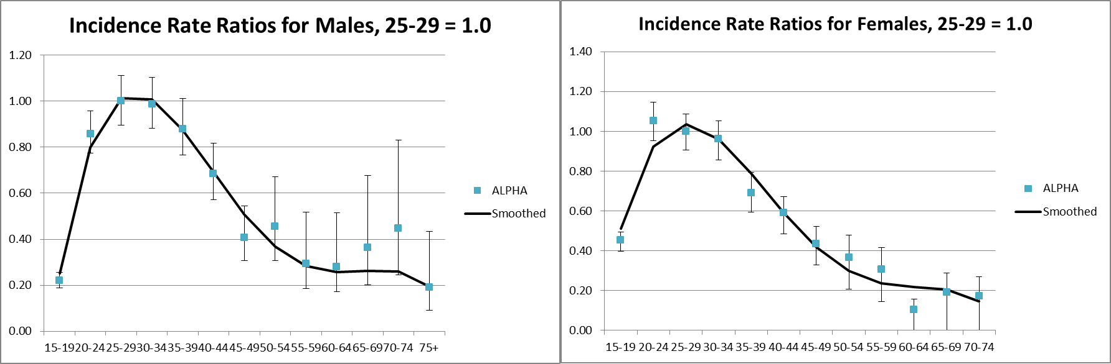
Incidence Rate Ratios: Generalized Epidemics
Notes:
Here we see the actual ratios used for males and females and how they compare to the ALPHA network data.

Slide 44
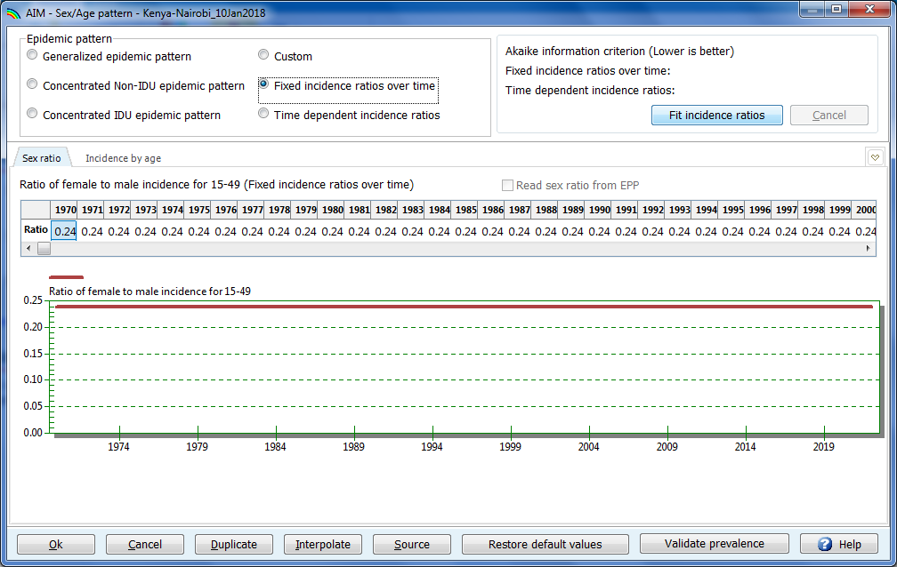
Spectrum now allows fitting of incidence ratios to data directly

Slide 45
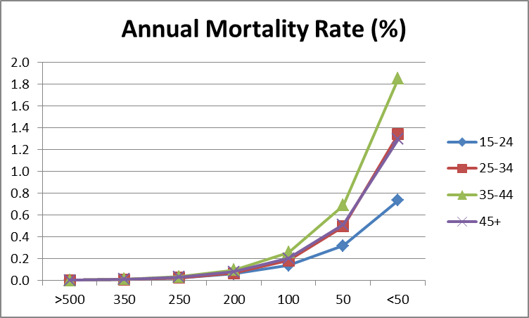
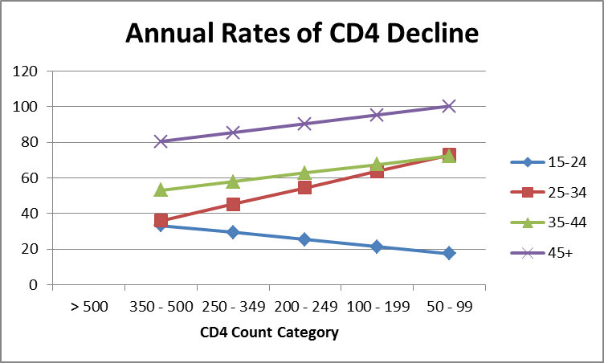
Mortality and Progression by CD4 Count
HIV-Related Mortality without ART
CD4 Count Progression Rates
Notes:
Mortality is also contingent on CD4, so the model estimates the annual rate of CD4 decline among patients not on ART, depending on their current “CD4 compartment”

Slide 46
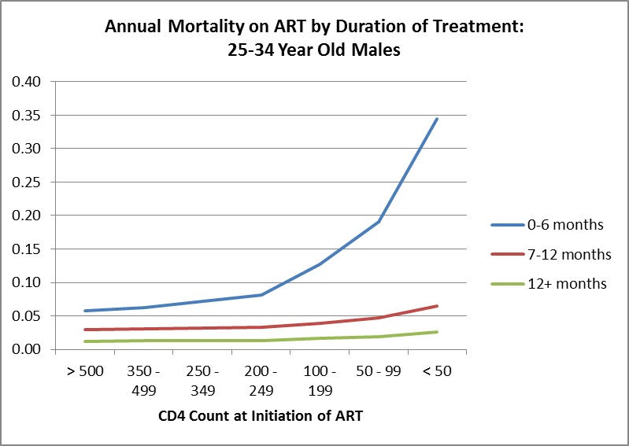
Mortality on ART by CD4 Count at Initiation by Duration
Adapted from Yiannoutsos et al. Estimated mortality of adult HIV-infected patients starting treatment with combination antiretroviral therapy Sex Transm Infect 2012;88:i33-i43.
Notes:
Once patients initiate treatment their outlook changes dramatically and improves over time. Those who have been on treatment for at least 12 months have the lowest mortality rates. Mortality rates also increase with reductions in CD4 at ART initiation.

Slide 47
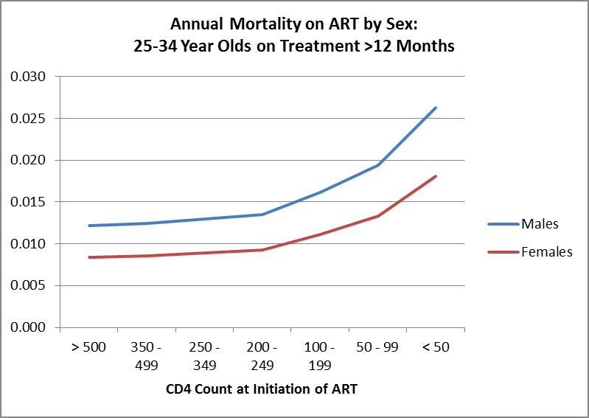
Mortality on ART by CD4 Count at Initiation by Sex
Adapted from Yiannoutsos et al. Estimated mortality of adult HIV-infected patients starting treatment with combination antiretroviral therapy Sex Transm Infect 2012;88:i33-i43.
Notes:
Also it is higher among men than women.

Slide 48
Pediatric Model Tracks Infections by CD4 Category and Timing of Infection
Children 0-4: CD4 percent
Children 5-14: CD4 count
>30
26-30
21-25
16-20
11-15
5-10
<5
>1000
750-999
500-749
350-499
200-349
<200
Timing of infection: Perinatal, 0-6 months, 7-12 months, 12+ months after birth

Slide 49
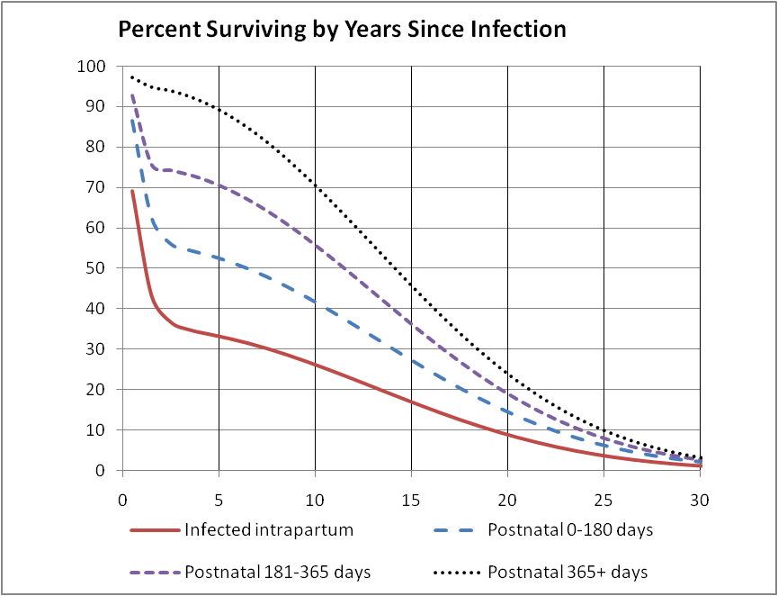
Child HIV-Related Mortality
Marston M, Becquet R. Net survival of children HIV-infected perinatally and through breastfeeding: a pooled analysis of individual data from resource-constrained settings, December 2010.
Notes:
Child mortality varies dramatically depending on when the infection occurs: intrapartum, postnatal early or later.

Slide 50
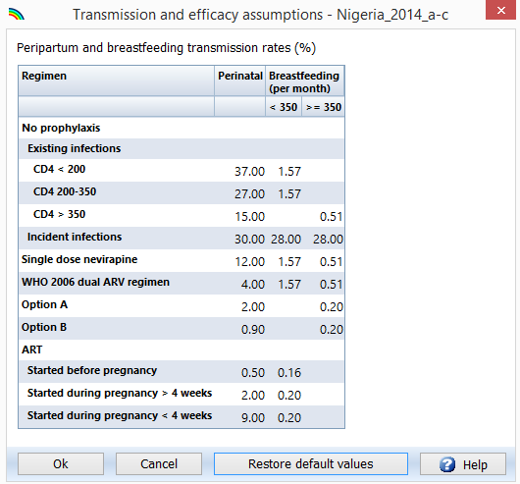
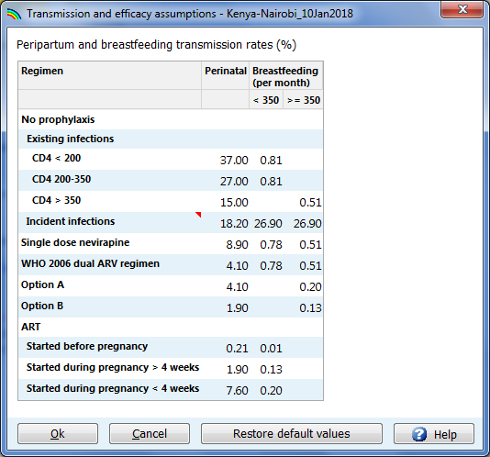
Mother-to-Child Transmission
Notes:
Transmission among children depends heavily on the prevention interventions that the mother and child receive as well as the duration of breastfeeding. These are the assumptions that were used in Spectrum in 2017. Recently, after several updated meta-analyses which included results that had not previously been available, many of these assumptions changed, generally leading to a reduction in transmission. For example, risk of infection during breastfeeding reduced from 1.57 to about 0.8%, while risk of transmission due to incident infection reduced from 30% to 18% intrapartum. Other risks were revised as well. How these risks result in an overall transmission rate depends on the mix of interventions that are in use in the country.

Slide 51
Fertility Effects of HIV Infection
Adapted from Jeff Eaton, Thomas Rehle, et al. Recent HIV prevalence trends among pregnant women and all women in sub-Saharan Africa: implications for HIV estimates, 2014, AIDS, 28 (Suppl 4).
Notes:
Wei-ju Chen and Neff Walker analyzed data from 20 DHS data sets to calculate the ratio of age-specific fertility among HIV+ and HIV- women. This

Slide 52
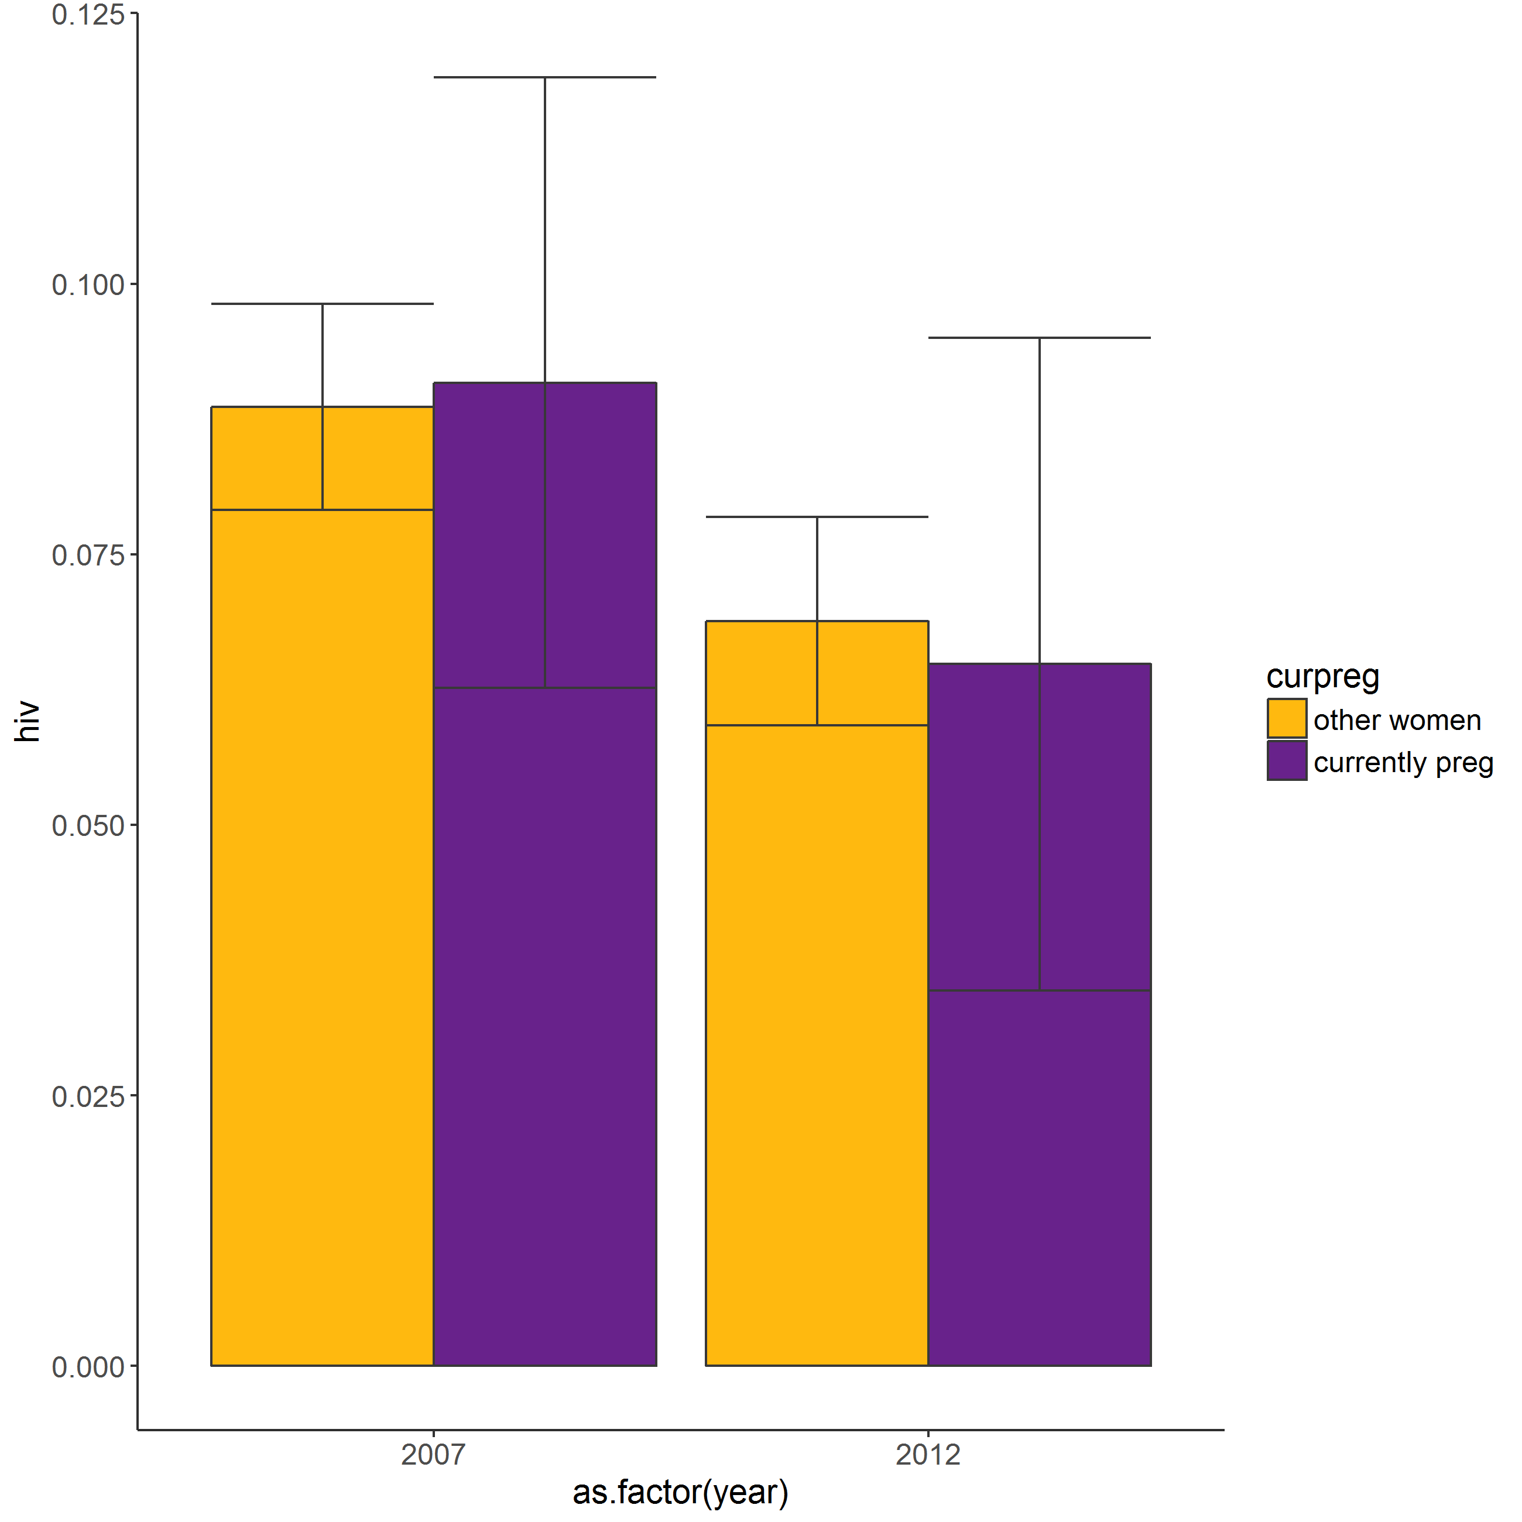
HIV prevalence in pregnant women – KAIS 2007, 2012
Although in many countries HIV prevalence is lower in pregnant women, in Kenya they appear to be similar based on KAIS 2007 and 2012

Slide 53
Acknowledgements (for all presentations in this session)
John Stover, Avenir Health, Inc (www.avenirhealth.org)
Jeff Eaton, Imperial College
UNAIDS Reference Group on Estimates, Modelling and Projections (www.epidem.org)

